Slide 1
Computer Science Journal
Name and period
Notes:
Add name and period, decorate with favorite CS related art

Slide 2
Brainstorm what you think you should learn in a computer science class:
List some great ideas here…..

Slide 3
What is Problem solving?
Problem Solving is: (Define, in your own words)

Slide 4
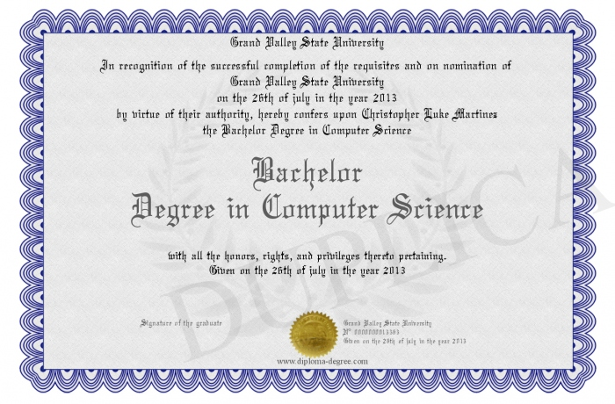
What jobs can a computer science degree get you?
Google and report back………
Notes:
What does a computer scientist do?

Slide 5
Course Grading
How do you think we should be graded?
Projects | Assignments/Quizzes | Participation

Slide 6
Favorite Computer Science Meme
Notes:
Insert your favorite school appropriate meme here

Slide 7
Important Links and Resources
https://www.hasdk12.org/Page/27625 Mrs. Kozlek’s Page
https://code.org/ Code.Org for majority of lessons
https://scratch.mit.edu/projects/editor/ Scratch

Slide 8
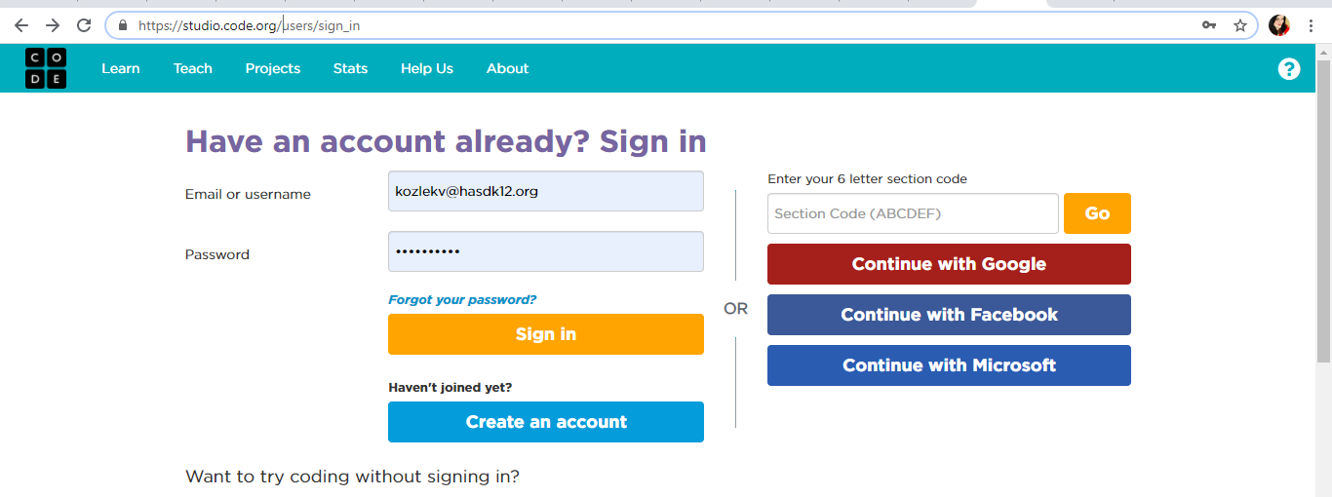
Create an Account on Code.org

Slide 9
Reflection Journal
Use this space to follow the daily reflection
Notes:
Right click on a slide in the left window to duplicate it. You can duplicate these slides as your journal grows!

